Slide 1
CS209: Computer Science II

Slide 2
Unit 2 Module 6:
Containers
Introducing Containers
Sequential Containers
Container Members
Array Class
Vector Class
Stack
Queue
Associative Containers
Sets
Maps

Slide 3
Containers
The STL provides three kinds containers:
Sequential Containers are containers where the ultimate position of the element depends on where it was inserted, not on its value.
Container Adapters use the sequential containers for storage, but modify the user interface to stack, queue or other structure.
Associative Containers maintain the data in sorted order to implement the container’s purpose. The position depends on the value of the element.

Slide 4
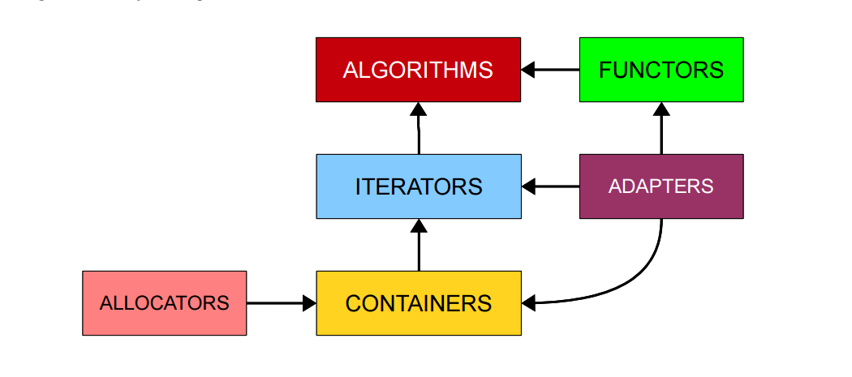
Containers
YOU ARE HERE

Slide 5
Sequential Containers
The STL sequential containers are the list, vector, array, forward-list, and deque. (The slist is not in the STL.)
Sequential means the container has a first, element, a second element and so on.
An STL list is a doubly linked list.
An STL vector is essentially an array whose allocated space can grow while the program runs. An STL array appeared with V11.
An STL deque (“d-que” or “deck”) is a “double ended queue”. Data can be added or removed at either end and the size can change while the program runs.

Slide 6
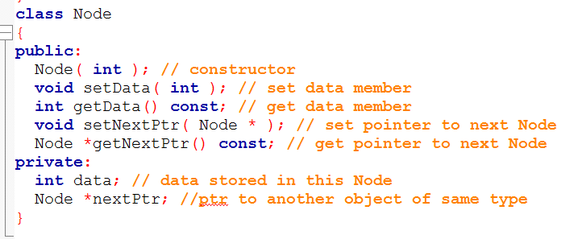
Self-referential class
Member nextPtr is referred to as a link

Slide 7
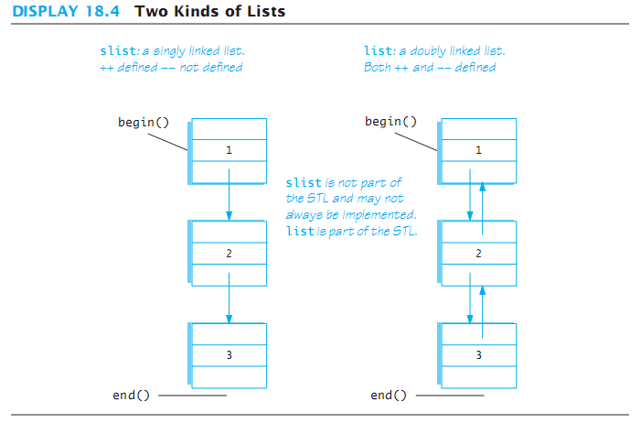
Sequential Containers

Slide 8
Common Container Members
The STL sequential containers each have different characteristics, but they all support these members:
container( ); // creates empty container
~container( ); // destroys container, erases all members
c.empty( ) // true if there are no entries in c
c.size( ) const; // number of entries in container c
c = v; //replace contents of c with contents of v

Slide 9
Common Container Members
container<T> c;
container<T> c(c2); // Defines c as a container that is empty or a copy of c2 if given.
container<T> c(n);
Defines c as a container with n elements that are value-initialized according to the type of T. If T is a class type, that type will control how to initialize the elements. If T is a built-in arithmetic type, then the elements will be initialized to 0.
container<T> c(n, t); // Defines c as a container with n elements that are copies of t.
container<T> c(b, e); // Creates a container that holds a copy of the elements denoted by iterators in the range [b, e).

Slide 10
More Common Container Members
c.swap(other_container); // swaps contents of // c and other_container.
c.push_back(item); // appends item to container c
c.begin( ); // returns an iterator to the first // element in container c
c.end( ); // returns an iterator to a position // beyond the end of the container c.
c.rbegin( ); // returns an iterator to the last element // in the container. Serves to as start of // reverse traversal.

Slide 11
More Common Container Members
c.rend( ); // returns an iterator to a position // beyond the of the container.
c.front( ); // returns the first element in the // container (same as *c.begin( );)
c.back( ); //returns the last element in the container // same as *(--c.end( ));
c.insert(iter, elem); //insert copy of element elem //before iter (range - like [b, e) of c.insert(d, b, e)
c.erase(iter); //removes element iter points to, returns an iterator // to element following erasure. returns c.end( ) if // last element is removed.

Slide 12
More Common Container Members
c.clear( ); // makes container c empty
c1 == c2 // returns true if the sizes equal and // corresponding elements in c1 and c2 are //equal
c1 != c2 // returns !(c1==c2)
c.push_front(elem) // insert element elem at the // front of container c. // NOT implemented for vector due to large // run-time that results

Slide 13
PITFALL: Iterators and Removing Elements
Removing elements invalidates some iterators.
erase member returns an iterator pointing to the next element past the erased element.
With list we are guaranteed that only iterators pointing to the erased element are invalidated.
With vector and deque, treat all operations that erase or insert as invalidating previous iterators.

Slide 14
Operation Support
Operation | Function | vector | List | deque
Insert at front | push_front(e) | - | X | X
Insert at back | push_back(e) | X | X | X
Delete at front | pop_front( ) | - | X | X
Delete at back | pop_back( ) | X | X | X
Insert in middle | insert(e) | (X) | X | (X)
Delete in middle | erase(iter ) | (X) | X | (X)
Sort | sort( ) | X | - | X
(X) Indicates this operation is significantly slower.

Slide 15
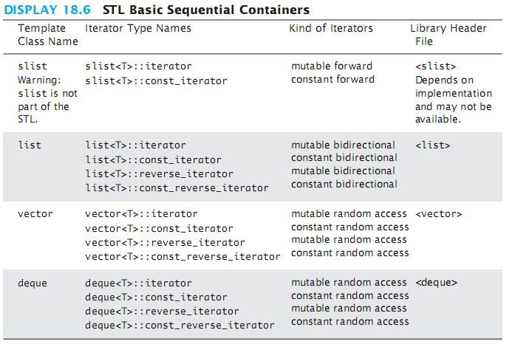
Operation Support

Slide 16
Arrays
The Standard Template Library has three variations on arrays:
template < typename T, size_t N >
class array;
template < typename T, class Alloc = allocator<T> >
class vector;
template < size_t N >
class bitset;

Slide 17
array<T, N>
This is a sequence container with a linear order
Elements are accessed by their position
The memory allocation is contiguous
Random access is Θ(1)
The memory is allocated at compile time

Slide 18
array<T, N>
To make return types more standard, the C++ STL defines specific member types associated with each class:
array<T, N>::value_type T
array<T, N>::reference T &
array<T, N>::const_reference T const &
array<T, N>::pointer T *
array<T, N>::const_pointer T const *
array<T, N>::iterator
array<T, N>::const_iterator
array<T, N>::reverse_iterator
array<T, N>::const_reverse_iterator
array<T, N>::size_type size_t
array<T, N>::difference_type ptrdiff_t

Slide 19
array<T, N>
Member functions include:
The eight iterators
begin end rbegin rend cbegin cend crbegin crend
iterator begin() noexcept;
const_iterator begin() const noexcept;
const_iterator cbegin() const noexcept;
Capacity
constexpr size_type size() noexcept;
constexpr size_type max_size() noexcept;
constexpr bool empty() noexcept;

Slide 20
array<T, N>
Member functions include:
Element access
reference operator[]( size_type );
const_reference operator[]( size_type ) const;
reference at( size_type );
const_reference at ( size_type ) const;
reference front();
const_reference front() const;
reference back();
const_reference back() const;
pointer data() noexcept;
const_pointer data() const noexcept;

Slide 21
array<T, N>
Member functions include:
Modifiers
void fill( const_reference );
void swap( array & ) noexcept( ... );

Slide 22
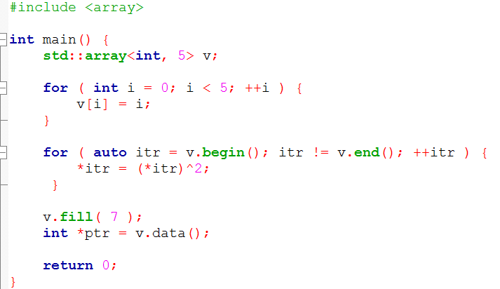
array<T, N>
0 1 2 3 4
2 3 0 1 6
7

Slide 23
vector<T>
This is a sequence container with a linear order
Elements are accessed by their position
The memory allocation is contiguous
Random access is Θ(1)
The array allocation is dynamic
The size of the array can change at runtime
The user can specify the method of allocation

Slide 24
vector<T>
To make return types more standard, the C++ STL defines specific member types associated with each class:
vector<T>::value_type T
vector<T>::reference T &
vector<T>::const_reference T const &
vector<T>::pointer T *
vector<T>::const_pointer T const *
vector<T>::iterator
vector<T>::const_iterator
vector<T>::reverse_iterator
vector<T>::const_reverse_iterator
vector<T>::allocator_type allocate<value_type>
vector<T>::size_type size_t
vector<T>::difference_type ptrdiff_t

Slide 25
vector<T>
Member functions include:
Constructors
explicit vector();
explicit vector( size_type );
vector( size_type, const_reference );
template < class InputIterator >
vector( InputIterator first, InputIterator last );
vector( vector const & );
vector( vector && );
vector( initializer_list<value_type> );

Slide 26
vector<T>
Member functions include:
Assignment operator
vector &operator=( vector const & );
vector &operator=( vector && );
vector &operator=( initializer_list<value_type> );
The last lets us:
std::vector<int> v(10);
v = {1, 2, 3, 4, 5, 6, 7, 8, 9, 10};

Slide 27
vector<T>
Member functions include:
The eight iterators
begin end rbegin rend cbegin cend crbegin crend
Each has the various signatures:
iterator begin() noexcept;
const_iterator begin() const noexcept;
const_iterator cbegin() const noexcept;

Slide 28
vector<T>
Member functions include:
Capacity
size_type size() const noexcept;
size_type capacity() const noexcept;
size_type maxsize() const noexcept;
void resize( size_type );
void resize( size_type, const_reference );
bool empty() const noexcept;
bool empty() const noexcept;
void reserve( size_type );
void shrink_to_fit();

Slide 29
vector<T>
Member functions include:
Element access
reference operator[]( size_type );
const_reference operator[]( size_type ) const;
reference at( size_type );
const_reference at ( size_type ) const;
reference front();
const_reference front() const;
reference back();
const_reference back() const;
pointer data() noexcept;
const_pointer data() const noexcept;

Slide 30
vector<T>
Member functions include:
Modifiers
template < class Iterator >
void assign( Iterator, Iterator );
void assign( size_type, const_reference );
void assign( initializer_list<value_type> );
void push_back( const_reference );
void push_back( value_type&& );
void pop_back();

Slide 31
vector<T>
Member functions include:
Modifiers
iterator insert( const_iterator position, const_reference );
iterator insert( const_iterator position, size_type n,
const_reference );
template < class Iterator >
iterator insert( const_iterator position,
Iterator first, Iterator last );
iterator insert( const_iterator position, value_type&& );
iterator insert( const_iterator position,
initializer_list<value_type> );

Slide 32
vector<T>
Member functions include:
Allocator
allocator_type get_allocator() const noexcept;
Non-member function overloads
template < typename T >
void swap( vector<T> &, vector<T> & );
template < typename T >
bool operator==( const vector<T> &, const vector<T> & );
Includes the relational operators !=, <, <=, >, and >=
Uses a lexicographical comparison

Slide 33
vector<bool>
One specialization of vector is for Boolean values:
Normally, each bool occupies one byte
Reasonable specializations of vector<bool> use one bit per entry
One new function:
void flip() noexcept;
A mechanism for referencing individual bits and interpreting them as type bool

Slide 34
vector<T, Alloc>
One thing that has been overlooked is: how is memory allocated?
By default, memory allocation is performed using new[] and delete[]
What if this is too slow or inappropriate for a particular use of vector?
The actual class definition is:
template < typename T, class Alloc = allocator<T> >
class vector;

Slide 35
vector<T, Alloc>
An allocator class must have specific member types and functions:
template <class T>
class Allocator {
public:
typedef T value_type;
typedef T * pointer;
typedef const T * const_pointer;
typedef T & reference;
typedef const T & const_reference;
typedef std::size_t size_type;
typedef std::ptrdiff_t difference_type;
typedef propagate_on_container_move_assignment true_type;
template <class U>
struct rebind {
typedef Allocator<U> other;
};

Slide 36
vector<T, Alloc>
allocator() nothrow;
allocator ( const allocator & ) nothrow;
template <class U>
allocator( const allocator<U> & ) nothrow;
~allocator() throw;
pointer address( reference ) const noexcept;
const_pointer address( const_reference ) const noexcept;
pointer allocate( size_type, allocator<void>::const_pointer = 0 );
void deallocate( pointer, size_type );
size_type max_size() const nothrow;
template <class U, class... Args>
void construct( U* p, Args&&... args );
template <class U>
void destroy ( U* p );
};

Slide 37
vector<T, Alloc>
Why would you want a different allocator?
Suppose you want persistent memory allocation—allocation that continues from one execution of a program to the next
Intel’s thread building blocks improve the performance of multithreaded applications by using
std::vector< T, tbb::scalable_allocator<T> >
Electronic Arts has a STL optimized for gaming software—memory tends to be more restrictive on gaming platforms
Tracking allocations and deallocations for debugging or efficiency
Suppose you want to use memory-mapped files—addresses in memory that are mapped not to RAM but to virtual memory
From the point of view of portability, all the machine-specific things which relate to the notion of address, pointer, and so on, are encapsulated within a tiny, well-understood mechanism.
Alex Stepanov, designer of the STL
http://stackoverflow.com/questions/826569/compelling-examples-of-custom-c-stl-allocators

Slide 38
The Container Adapters stack and queue
Container Adapters use sequence containers for storage but supply a different user interface.
A stack uses a Last-In-First-Out discipline.
A queue uses a First-In-First-Out discipline.
A priority queue keeps its items sorted on a property of the items called the priority, so that the highest priority item is removed first.
The deque is the default container for both stack and queue.
A vector cannot be used for a queue as the queue requires operations at the front of the container.

Slide 39
Container Adapter stack
Declarations:
stack<T> s; // uses deque as underlying store
stack<T, underlying_container> t ;
//uses the specified //container as underlying container for stack
Stack<T> s (sequence_container);
// initializes stack to
// to elements in sequence_container.
Header:
#include <stack>
Defined types:
value_type, size_type
No iterators are defined.

Slide 40
The STL stack container
Stack template can be implemented as a vector, a linked list, or a deque
Implements push, pop, and empty member functions
Implements other member functions:
size: number of elements on the stack
top: reference to element on top of the stack

Slide 41
stack Member Functions
Sample Member Functions
Member function | Returns
s.size( ) | number of elements in stack
s.empty( ) | true if no elements in stack else false
s.top( ) | reference to top stack member
s.push(elem) | void Inserts copy of elem on stack top
s.pop( ) | void function. Removes top of stack.
s1 = = s2 | true if sizes same and corresponding pairs of elements are equal, else false

Slide 42
Defining a stack
Defining a stack of chars, named cstack, implemented using a vector:
stack< char, vector<char>> cstack;
implemented using a list:
stack< char, list<char>> cstack;
implemented using a deque:
stack< char > cstack;
When using a compiler that is older than C++ 11, be sure to put spaces between the angled brackets that appear next to each other.
stack< char, vector<char> > cstack;

Slide 43
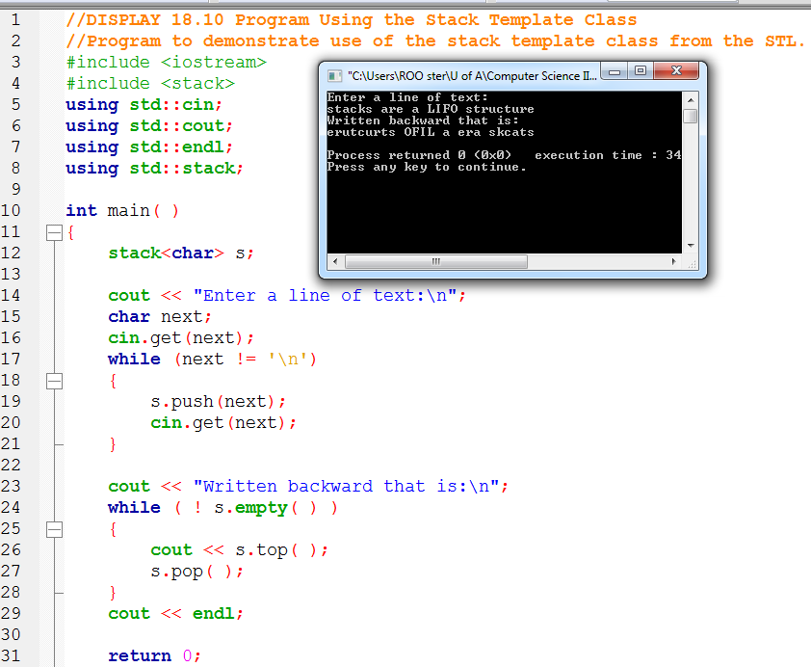
stack Member Functions

Slide 44
#include <iostream>
#include <vector>
#include <stack>
using namespace std;
int main()
{
const int MAX = 8; // Max value to store in the stack
int count; // Loop counter
// Define an STL stack
stack< int, vector<int> > iStack;
// Push values onto the stack.
for (count = 2; count < MAX; count += 2)
{
cout << "Pushing " << count << endl;
iStack.push(count);
}

Slide 45
// Display the size of the stack.
cout << "The size of the stack is ";
cout << iStack.size() << endl;
// Pop the values of the stack.
for (count = 2; count < MAX; count += 2)
{
cout << "Popping " << iStack.top() << endl;
iStack.pop();
}
return 0;
}

Slide 46
Container Adapter queue
Declarations:
queue<T> q; // uses deque as underlying store
queue<T, underlying_container> q ;
//uses the specified //container as underlying container for queue
Stack<T> s (sequence_container);
// initializes queue to
// to elements in sequence_container.
Header:
#include <queue>
Defined types:
value_type, size_type
No iterators are defined.

Slide 47
queue Member Functions
Sample Member Functions
Member function | Returns
q.size( ) | number of elements in queue
q.empty( ) | true if no elements in queue else false
q.front( ) | reference to front queue member
q.push(elem) | void adds a copy of elem at queue rear
q.pop( ) | void function. Removes front of queue.
q1 == q2 | true if sizes same and corresonding pairs of elements are equal, else false

Slide 48
The STL deque and queue Containers
deque: a double-ended queue. Has member functions to enqueue (push_back) and dequeue (pop_front)
queue: container ADT that can be used to provide queue as a vector, list, or deque. Has member functions to enque (push) and dequeue (pop)

Slide 49
Defining a queue
Defining a queue of chars, named cQueue, implemented using a deque:
deque<char> cQueue;
implemented using a queue:
queue<char> cQueue;
implemented using a list:
queue<char, list<char>> cQueue;

Slide 50
Associative Containers set and map
Associative containers keep elements sorted on a some property of the element called the key.
Only the first insertion of a value into a set has effect.
The order relation to be used may be specified: set<T, OrderRelation> s;
The default order is the < relational operator for both set and map.
This means that you can store all primitive types in a set, along with strings and other STL containers. However, you cannot store custom structs inside of an STL set.

Slide 51
The set Associative Container
Declarations:
set<T> s; // uses deque as underlying store
set<T, Ordering> s ; //uses the specified // order relation to sort elements in the set // uses < if no order is specified.
Header:
#include <set>
Defined types:
value_type, size_type
Iterators: iterator, const_iterator, reverse_iterator, const_reverse_iterator

Slide 52
The set Associative Container
no need to specify a location for the new element:
set<int> mySet;
mySet.insert(198); // Now contains: 198
mySet.insert(46); // Now contains: 46 198
mySet.insert(198); // Now contains: 46 198
if(mySet.count(137))
cout << "137 is in the set." << endl; // Printed
if(!mySet.count(500))
cout << "500 is not in the set." << endl; // Printed

Slide 53
The set Associative Container
To remove an element from a set, you use the erase function:
mySet.erase(137); // Removes 137, if it exists.
The STL set also supports several operations common to all STL containers. You can remove all elements from a set using clear, check how many elements are present using size, etc

Slide 54
set Member Functions
function | Returns
s.size( ) | number of elements in set
s.empty( ) | true if no elements in set else false
s.insert(el) | Insert elem in set. No effect if el is a member
s.erase(itr) | Erase element to which itr refers
s.erase(el) | Erase element el from set. No effect if el is not a member
s.find(el) | Mutable iterator to location of el in set if present, else returns s.end( )
s1 == s2 | true if sizes same and corresponding pairs of elements are equal, else false

Slide 55
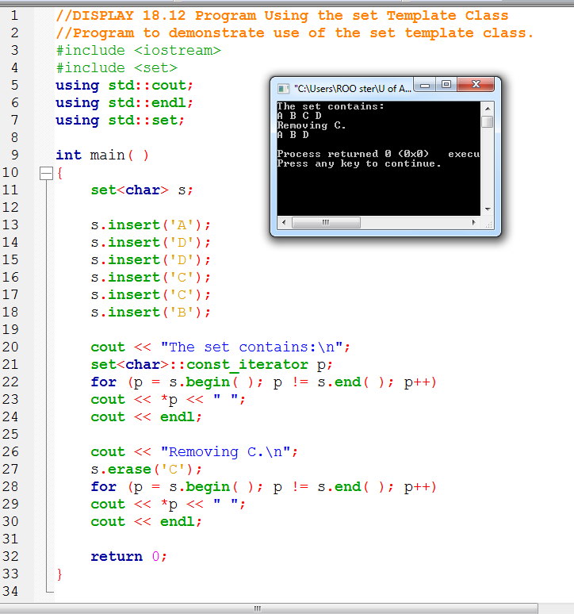
Holds char type
Traverse through the set using an bidirectional iterator

Slide 56
Maps
Associative container that associates objects of type Key with objects of type Data
Sorted according to keys
Map
Stores (key, object) pairs
Unimodal: duplicate keys not allowed
considered equivalent (not unique) if neither compares less than the other: !comp(a, b) && !comp(b, a).
AKA: table, associative array

Slide 57
map Member Functions
Function | Returns
m.size( ) | number of pairs in the map
m.empty( ) | true if no pairs are in the map else false
m.insert(el) el is a pair <key, T> | Inserts el into map. Returns <iterator, bool>. If successful, bool is true, iterator points to inserted pair. Otherwise bool is false
m.erase(key) | Erase element with key value key from map.
m.find(el) | Mutable iterator to location of el in map if present, else returns m.end( )
m1 = = m2 | true if maps contain the same pairs, else false
m[target] | Returns a reference to the map object associated to a key of target.

Slide 58
Map Container
Implements a key-value relationship
Programmer can use a key to access corresponding values
Example: key could be a part number such as A24-57 that corresponds to a part: 8.75 price and Martin manufacturer
A22-56
A23-57
A24-57
A24-57 | 8.75 | Martin
A22-56 | 12.50 | Calloway
A23-57 | 4.95 | Mirage

Slide 59
The STL Map Template
#Include <map>
Map<key, element> name_of_the_map
MAP <Int, string> mymap;
mymap[3] = “CS1 is fun”;
mymap<int, string> :: const_iterator mymapiterator
For
(mymapiterator = (mymap.begin());
mymapiterator != (mymap.end());
++mymapiterator)
mymapiterator -> first and mymapiterator -> second
Arrow operator -> points to the int and string here in our map

Slide 60
The STL Map Template
mymap[3] = “CS2 is fun”;
Mymap.insert(map<int, string>value_type(3, “CS2 is fun”);
Mymap.insert(pair<int, string>(3, “CS2 is fun”);
Mymap.insert(make_pair(3, “CS2 is fun”);
map<int, string> :: iterator insert = mymap.begin();
Mymap.insert(begin (pair<int, string>(3, “CS2 is fun”);
pair<iterator, bool> insert(const value_type &x)
Inserts x into the map
void insert(iterator, iterator)
Inserts a range into the map

Slide 61
STL Map Template
void erase(iterator pos)
Erases the element pointed to by pos
size_type erase(const key_type &key)
Erases the element whose key is k
void erase(iterator first, iterator last)
Erases all elements in a range
iterator find(const key_type &key)
Finds an element whose key is k.
data_type &operator[](const key_type &key)
Returns a reference to the object that is associated with a particular key.
If the map does not already contain such an object, operator[] inserts the default object data_type()

Slide 62
Map (an associative array)
For a vector, you subscript using an integer
For a map, you can define the subscript to be (just about) any type
int main()
{
map<string,int> words; // keep (word,frequency) pairs
for (string s; cin>>s; )
++words[s]; // note: words is subscripted by a string
// words[s] returns an int&
// the int values are initialized to 0
for (const auto & p : words)
cout << p.first << ": " << p.second << "\n";
}
Key type
Value type

Slide 63
Map
After vector, map is the most useful standard library container
Maps (and/or hash tables) are the backbone of scripting languages
A map is really an ordered balanced binary tree
By default ordered by < (less than)
For example, map<string,int> fruits;
fruits:
Orange 99
Map node:
Key first
Value second
Node* left
Node* right
…
Grape 100
Quince 0
Apple 7
Kiwi 2345
Plum 8

Slide 64
//Program to demonstrate use of the map template class.
#include <iostream>
#include <map>
#include <string>
using std::cout;
using std::endl;
using std::map;
using std::string;
int main( )
{
MAP CLASS INCLUDE

Slide 65
map<string, string> planets;
planets["Mercury"] = "Hot planet";
planets["Venus"] = "Atmosphere of sulfuric acid";
planets["Earth"] = "Home";
planets["Mars"] = "The Red Planet";
planets["Jupiter"] = "Largest planet in our solar system";
planets["Saturn"] = "Has rings";
planets["Uranus"] = "Tilts on its side";
planets["Neptune"] = "1500 mile-per-hour winds";
planets["Pluto"] = "Dwarf planet";
cout << "Entry for Mercury - " << planets["Mercury"]
<< endl << endl;
if (planets.find("Mercury") != planets.end( ))
cout << "Mercury is in the map." << endl;
if (planets.find("Ceres") == planets.end( ))
cout << "Ceres is not in the map." << endl << endl;
cout << "Iterating through all planets: " << endl;
map<string, string>::const_iterator iter;
for (iter = planets.begin( ); iter != planets.end( ); ++iter)
{
cout << iter->first << " - " << iter->second << endl;
}
return 0;
The iterator will
output the map in
order sorted by
the key. In this
case, the output
will be listed
alphabetically by
planet.

Slide 66
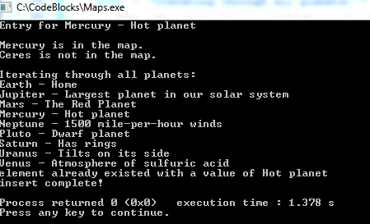
pair<map<string, string>::iterator,bool> retVar;
retVar = planets.insert(pair<string, string>("Mercury", "Hot planet"));
if (retVar.second==false)
{
cout << "element already existed";
cout << " with a value of " << retVar.first->second << '\n';
}
// Because element keys in a map are unique, the insertion operation checks whether
// each inserted element has a key equivalent to the one of an element already in the
// container, and if so, the element is not inserted, returning an iterator to this
// existing element (if the function returns a value).
retVar = planets.insert(pair<string, string>("Akron", "The planet on the hill"));
if (retVar.second == false)
{
cout << "element already existed";
cout << " with a value of " << retVar.first->second << '\n';
}
The pair combines the key and the mapped value. It’s from the STL, and separate, so needs the #include.

Slide 67
Map example (build some maps)
map<string,double> dow; // Dow-Jones industrial index (symbol,price)
dow["MMM"] = 81.86;
dow["AA"] = 34.69;
dow["MO"] = 54.45;
// …
map<string,double> dow_weight; // dow (symbol,weight)
dow_weight.insert(make_pair("MMM", 5.8549)); // just to show that a Map // really does hold pairs
dow_weight.insert(make_pair("AA",2.4808));
dow_weight.insert(make_pair("MO",3.8940)) // and to show that notation matters
// …
map<string,string> dow_name; // dow (symbol,name)
dow_name["MMM"] = "3M Co.";
dow_name["AA"] = "Alcoa Inc.";
dow_name["MO"] = "Altria Group Inc.";

Slide 68
Objects vs. Pointers to objects
STL Containers can store objects or pointers to objects
vector<Employee> OR vector<Employee *>
If a container stores objects, it will allocate and deallocate all memory for storing its elements
If a container stores pointers, the client is responsible for allocating and deallocating the objects
The client must call new and delete on the element objects
The container WILL NOT delete the objects for you

Slide 69
Efficiency
The STL was designed with efficiency as an important consideration.
STL requires compliant implementations to guarantee a maximum running time.
STL implementations strive to be optimally efficient.
Sorting is usually specified to be O(N*log(N)) where N is the number of items being sorted
Search is usually specified to be O(log(N)) where N is the number of items being searched.

Slide 70
Use ranged-for, auto with containers
C++11 ranged-for loop and auto keyword make it easier to iterate through containers. Consider the following map and set:
We can iterate through each container conveniently with a ranged for loop and auto:
map<int, string> personIDs = { {1,"Walt"},
{2,"Kenrick"} };
set<string> colors = {"red","green","blue"};
for (auto p : personIDs) cout << p.first << " " << p.second << endl; for (auto p : colors) cout << p << " ";

Slide 71
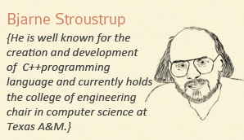
The STL came to life in 1992. You can download the entire STL.

Slide 72
References
Slide contributions include:
Walter Savitch, Problem solving with C++ (9th Edition). Addison-Wesley Longman Publishing Co., Inc. Boston, MA, USA ©2015
Gaddis, Starting Out with C++: From Control Structures through Objects, (8th Ed.) , Addison-Wesley Longman Publishing Co., Inc. Boston, MA, USA ©2015
Bjarne Stroustrup, The C++ Programming Language, 3rd Edition, Addison-Wesley Longman Publishing Co., Inc. Boston, MA, USA ©2007
Herb Sutter, Andrei Alexandrescu, C++ coding standards : 101 rules, guidelines, and best practices, Copyright © 2005 Pearson Education, Inc.
Paul Deitel & Harvey Deitel, C++ How to Program, (7th Ed.) © 2010 by Pearson Education, Inc.
Upper Saddle River, New Jersey 07458
Scott Meyers, Effective Modern C++. Copyright © 2015 (O’Reilly) , 978-1-491-90399-5.
Andrew Koenig and Barbara E. Moo, Accelerated C++ Practical Programming by Example,
Addison-Wesley, 2000 ISBN 0-201-70353-X

Slide 73
References
Slide contributions include:
Frank M. Carrano. Data Abstraction & Problem Solving with C++ (5th Edition)
Addison-Wesley Longman Publishing Co., Inc. Boston, MA, USA ©2006
TutorialsPoint - http://www.tutorialspoint.com/cplusplus/
Cplusplus.com - http://www.cplusplus.com/doc/tutorial/
http://www.keithschwarz.com/cs106l/fall2010/course-reader/Ch5_STLSequenceContainers.pdf

